Slide 1
CSE 471 - Lab 08
Data Flow Diagram

Slide 2
Data Flow Diagram
Process modeling
Flow of information among processes, external entities, data stores
Context Diagram
Overview of entire system
System as a single process
Identify external entities and data flow
Level 1 Diagram
Major sub-processes of the system represented by Context diagram
Must balance in accordance with Context diagram

Slide 3
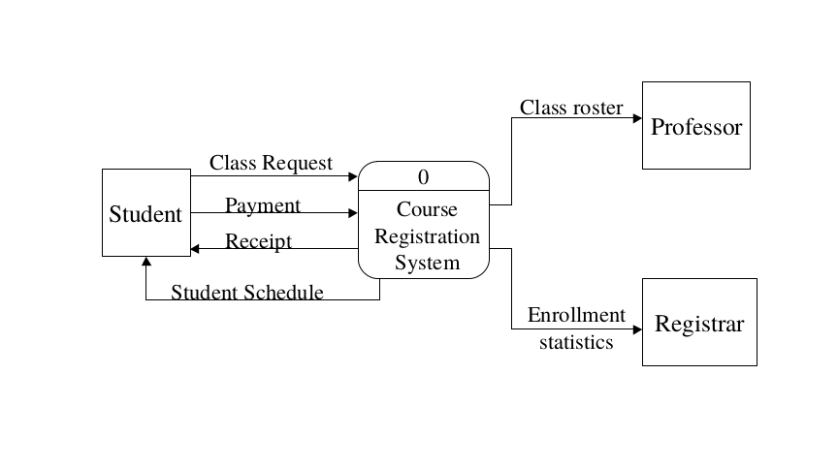
Course Registration System

Slide 4
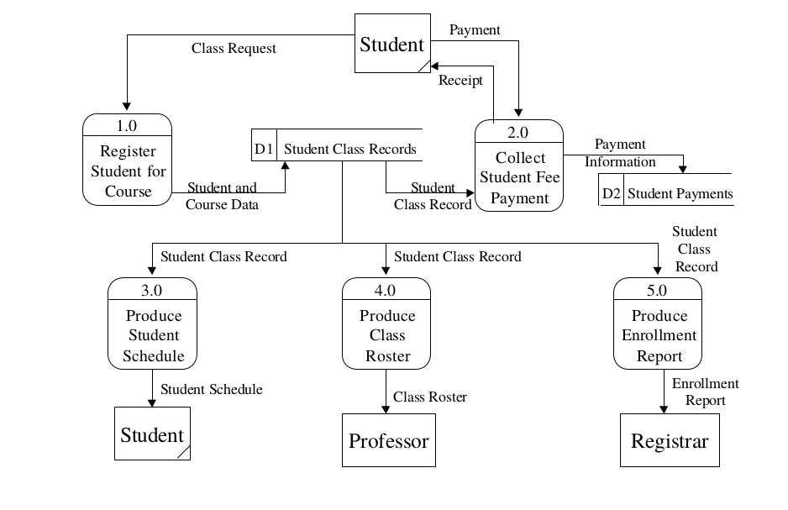

Slide 5
Scenario : Movie Rental System

Slide 6
Scenario : Movie Rental System
MovieMania is a small movie rental store. The store lends movies to customers for a fee, and purchases its movies from a DVD supplier corporation. A customer wishing to borrow a movie provides the empty box of the movie they desire, their membership card, and payment – payment is always with the credit card used to open the customer account. The customer then returns the movie to the store after watching it. If a loaned movie is overdue by a day the customer's credit card is charged, and a reminder letter is sent to them. Each day after that a further card is made, and each week a reminder letter is sent. This continues until either the customer returns the movie, or the charges are equal to the cost of replacing the movie. New customers fill out a form with their personal details and credit card details, and the counter staff give the new customer a membership card. Each new customer’s form is added to the customer file. The movie supplier sends a list of available titles to MovieMania, who decide whether to send them an order and payment. If an order is sent then the supplier sends the requested movies to the store. For each new movie a new stock form is completed and placed in the stock file.

Slide 7
Scenario : Movie Rental System
MovieMania is a small movie rental store. The store lends movies to customers for a fee, and purchases its movies from a DVD supplier corporation. A customer wishing to borrow a movie provides the empty box of the movie they desire, their membership card, and payment – payment is always with the credit card used to open the customer account. The customer then returns the movie to the store after watching it. If a loaned movie is overdue by a day the customer's credit card is charged, and a reminder letter is sent to them. Each day after that a further card is made, and each week a reminder letter is sent. This continues until either the customer returns the movie, or the charges are equal to the cost of replacing the movie. New customers fill out a form with their personal details and credit card details, and the counter staff give the new customer a membership card. Each new customer’s form is added to the customer file. The movie supplier sends a list of available titles to MovieMania, who decide whether to send them an order and payment. If an order is sent then the supplier sends the requested movies to the store. For each new movie a new stock form is completed and placed in the stock file.

Slide 8
Scenario : Movie Rental System
MovieMania is a small movie rental store. The store lends movies to customers for a fee, and purchases its movies from a DVD supplier corporation. A customer wishing to borrow a movie provides the empty box of the movie they desire, their membership card, and payment – payment is always with the credit card used to open the customer account. The customer then returns the movie to the store after watching it. If a loaned movie is overdue by a day the customer's credit card is charged, and a reminder letter is sent to them. Each day after that a further card is made, and each week a reminder letter is sent. This continues until either the customer returns the movie, or the charges are equal to the cost of replacing the movie. New customers fill out a form with their personal details and credit card details, and the counter staff give the new customer a membership card. Each new customer’s form is added to the customer file. The movie supplier sends a list of available titles to MovieMania, who decide whether to send them an order and payment. If an order is sent then the supplier sends the requested movies to the store. For each new movie a new stock form is completed and placed in the stock file.

Slide 9
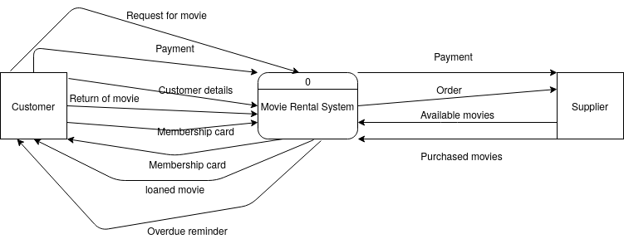

Slide 10
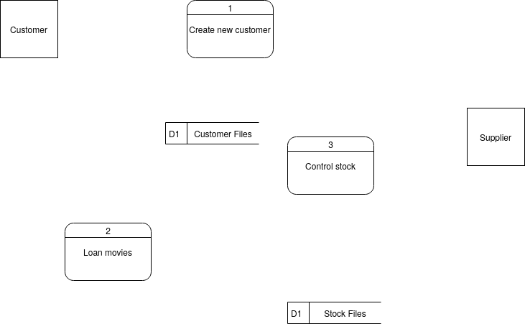

Slide 11
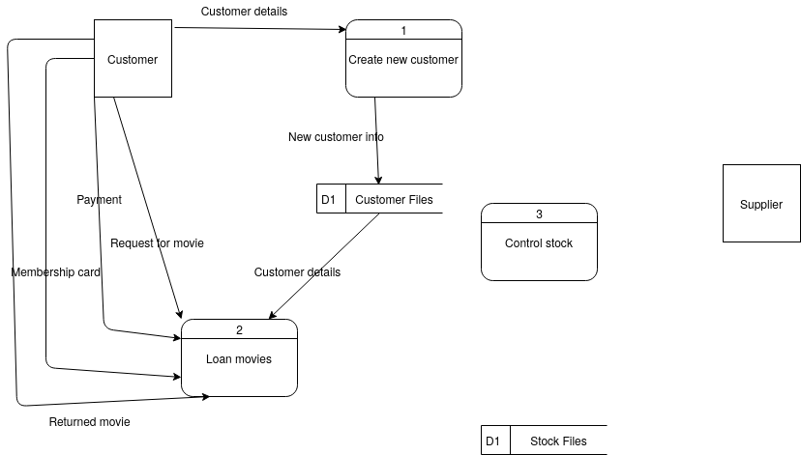

Slide 12
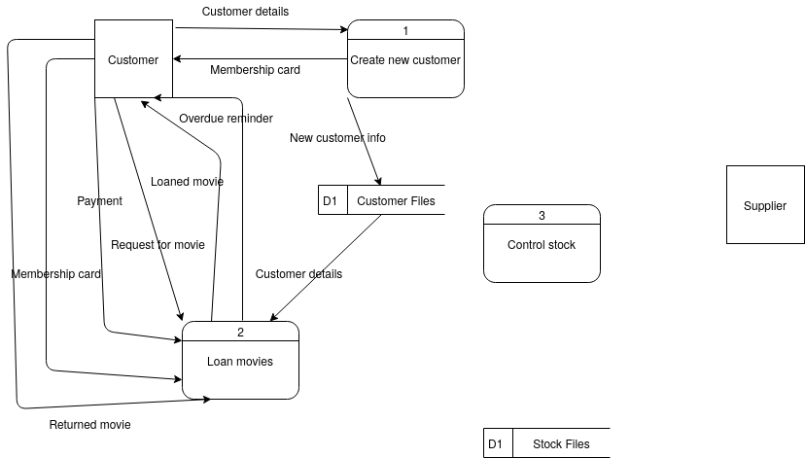

Slide 13
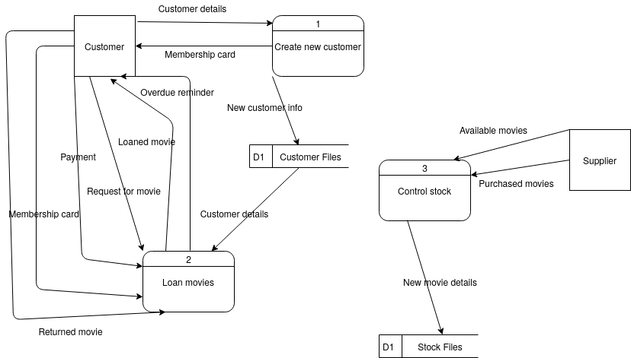

Slide 14
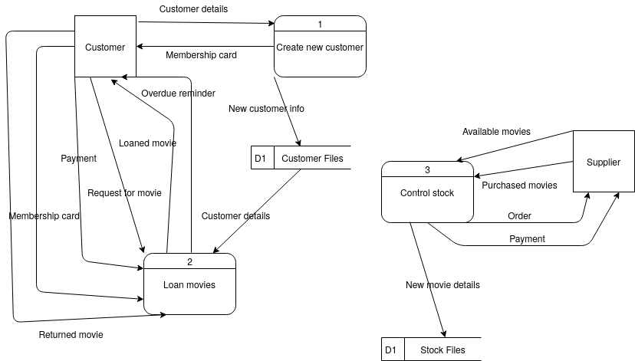

Slide 15
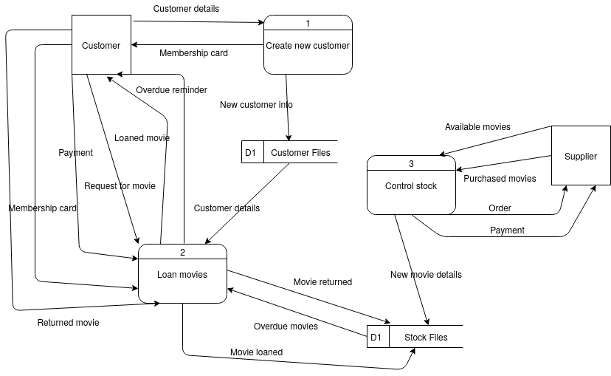

Slide 16
References
https://www.cs.uct.ac.za/mit_notes/software/htmls/ch06s06.html
UML Distilled A Brief Guide to the Standard Object Modeling Language, Martin Fowler

